Slide 1
Creative teaching
Erasmus + project Malta 2022
Dobrosława Kozłowska, Dorota Janik, Urszula Piasecka, Beata Przybylska-Rejment, Marzena Kacprzak

Slide 2
What is creative teaching?
Creative teacings is the ability to teach how to consider something in a new way.
Creative teaching means to teach how to think outside the box.

Slide 3
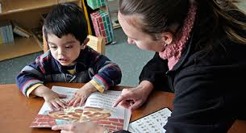
Creative teaching in:
Teaching the Blind and Partially sighted

Slide 4
Experiencing the exotic tastes
The teacher asks the Students to touch different kinds of foods in order to recognize the shape the structure, smell and finally to taste them.
The Students can use a pinaple, an opuntia, melon, olives, tuna, mussels, octopus( sea food),anchois and many others.
Then the blind Students make a dish out of the ingredients or those who are partially sighted can compose a picture of those igredients.
This excercise lets the Students explore new tastes and as a result overcome their taste barriers.

Slide 5
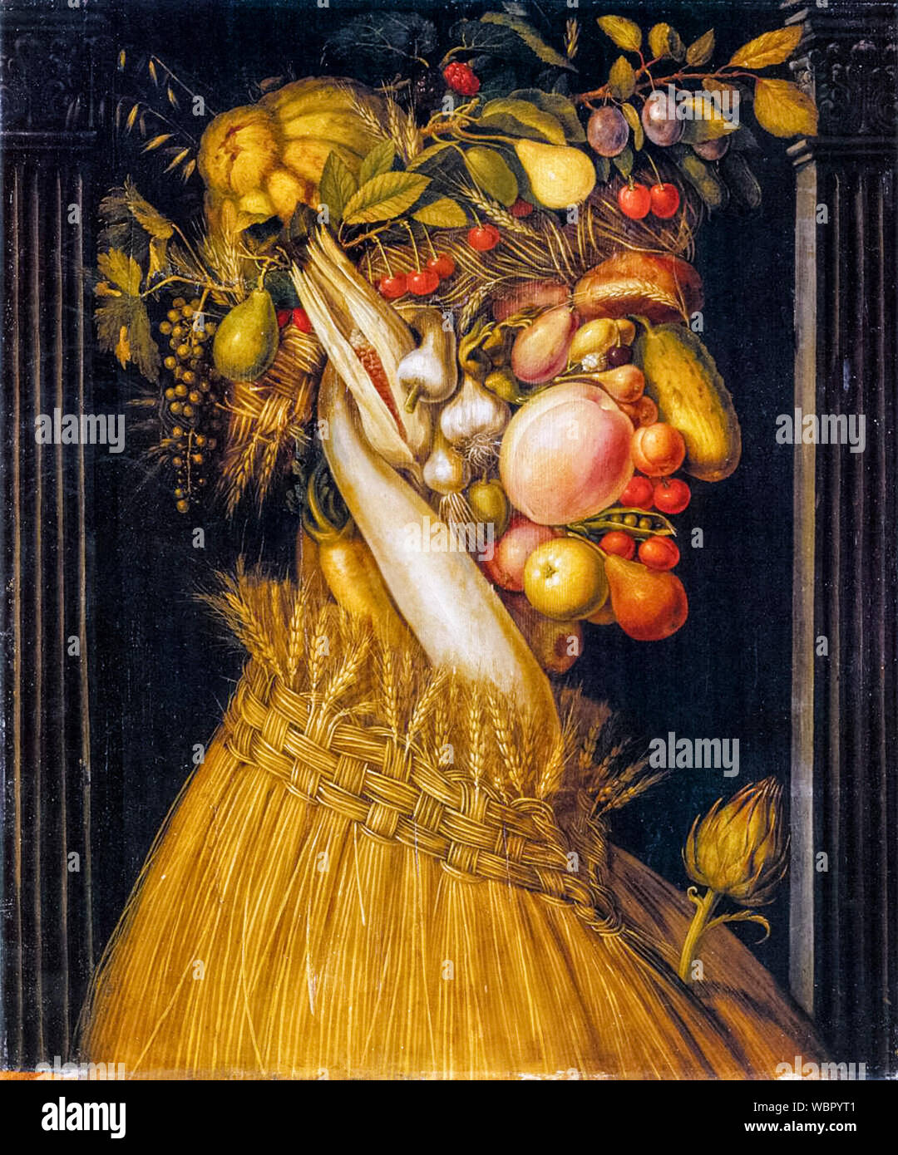
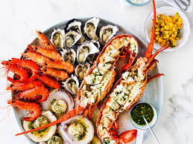

Slide 6
Creative teaching in :
Trade and customer service

Slide 7
The Ss have to organise a corner shop.
They have to put the goods on shelves, put prices on the goods, to prepare cash register, use the scanner to read the bare codes.
Then the customers come, some of them are very fussy.
The Students have to be able to serve all the custmers, even these who are fussy, to sell as many goods as possible.
The aim of this task is to learn how to organise work in a shop and to face some difficult situations wit troublesome customers.

Slide 8
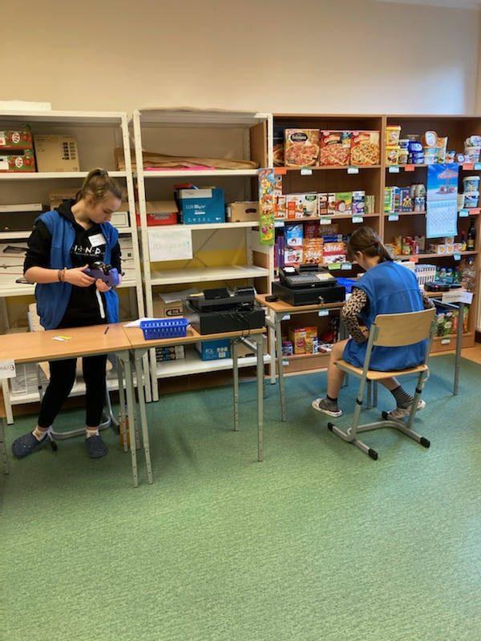

Slide 9
Creative teaching in:
English

Slide 10
Picture dictation
There are two Students involved, one sits back to the screen with a picture, the other one can see the picture.
One Student tells his classmate the details of the picture , the other one listens carefully to the instruction and draws the picture.
The aim of this execrcise is e. g. to learn how to use prepositions of place, recognize different shapes, how to give clear and precise instructions.

Slide 11
Creative teaching in
Religiuos education

Slide 12
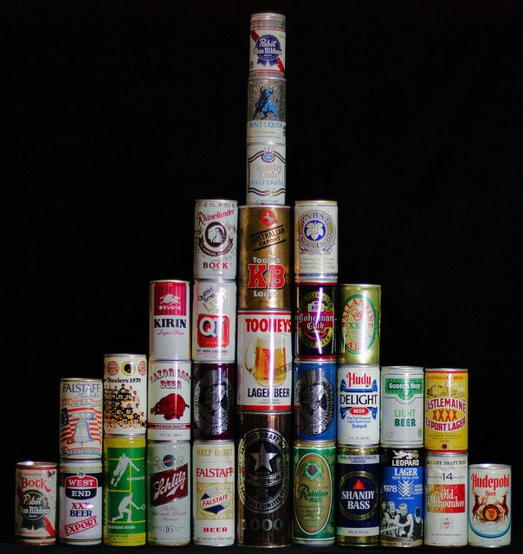
The example of creative teaching in religious education
The pyramid of faith
The Students build a pyramid of cans – we all asume that this a symbol of our faith.
The teacher puts a thesis:
In Jerusalem bones of a human being have been discoverd, it might be a body of Jesus Christ.
Our faith looses its basis, Students pull down the pyramid.

Slide 13
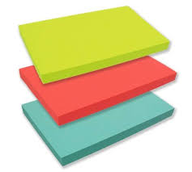
We seek together the biblical and non biblical arguments for
The Ressurection of Jesus
Both the Students and the teacherand rebuild the pyramid sticking information for and aganinst the thesis.

Slide 14
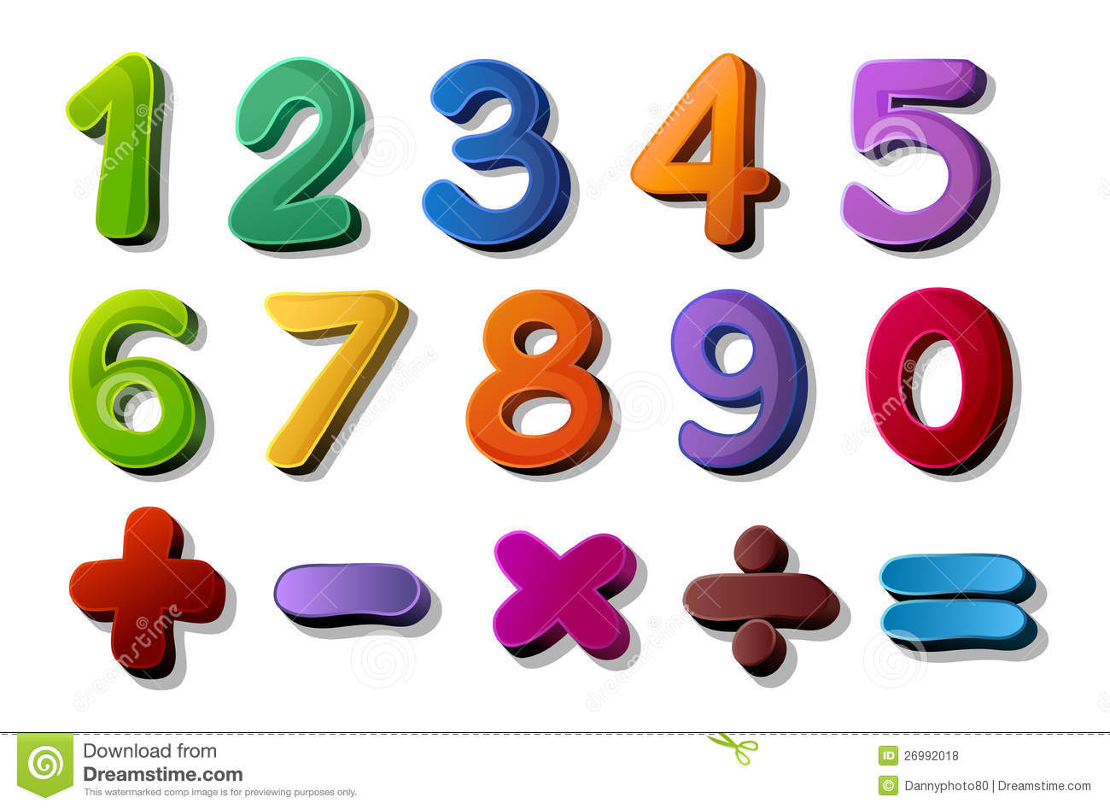
Creative teaching in:
Maths

Slide 15
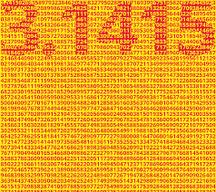
Creative teaching in Maths:
Pi number, 3,1415
The Students are given a portion of beans and they have to weigh it.
The group of Students who can weigh the closest portion to 3,14(Pi numer) wins.
The aim of this exercice is to learn about irrational numbers.

Slide 16
Thank you for your attention☺

